Slide 1

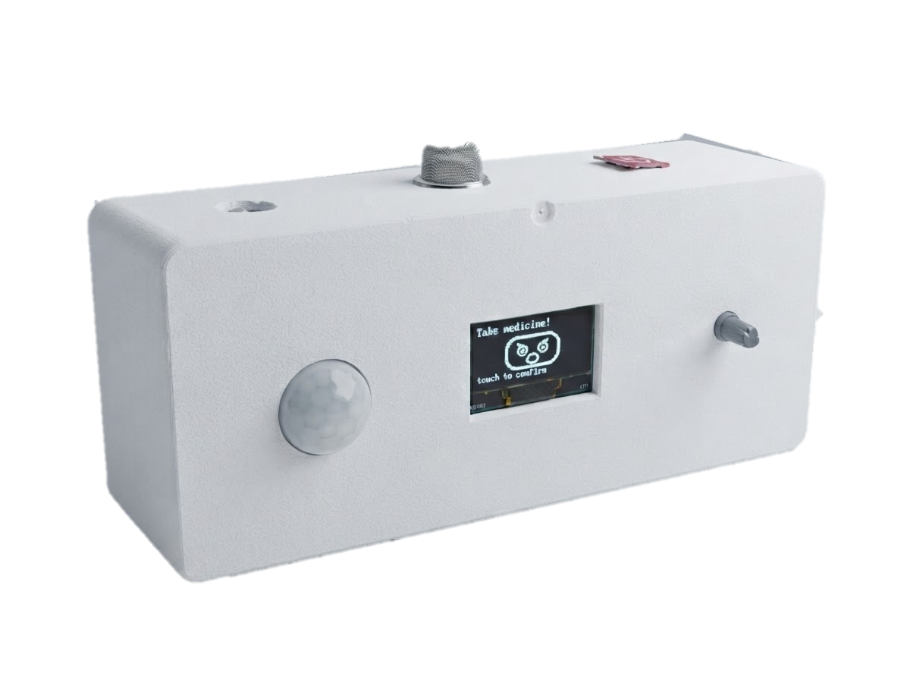





Smart
Medicine
Companion
Robot PicoBot
Your Smart Reminder, Your Health Partner
Medicine
Reminder
Voice
Assistant
Face
Reaction
Movement
Detection
Emergency
SMS
01

Slide 2

Team Members
Faiaz Masnun Labib
Sadia Shahrin Sharna
Adika Sultana
ID: 23101128
ID: 23101161
ID: 23101162
02

Slide 3




Problem Statement
Many elderly or chronically ill patients simply forget medicine timing, dosage, or whether they already took it.
Even when reminded, many skip medicine on purpose — low mood, denial, or simply not feeling like it.
Reminder apps only fight forgetting — they can't sense reluctance or confirm the dose was truly taken.
Caregivers can't always be present, leaving emergencies or emotional low points without easily accessible help.
03

Slide 4



Why We Choose This
Topic?
Non-adherence has two causes — forgetting and unwillingness — yet most tools fix only the first.
Combines robotics, AI voice, affective computing, and IoT to address both memory and motivation.
Supports independent living and emotional well-being, not just pill-time alerts.
Backed by recent adherence and social-robotics research — scalable, research-grounded design.
04

Slide 5
Objectives
Emotional
Engagement
Design a reliable medicine reminder and confirmation system using RTC scheduling, voice alerts, and button-press verification to directly counter forgetting.
Develop an emotionally intelligent voice assistant that detects reluctance and uses empathetic persuasion and mood-aware expressions to address emotional refusal.
Movement
Detection
Integrate presence and movement detection so the robot proactively engages users who try to avoid or ignore reminders.
Reminder &
Confirmation
Build a gas-leak detection and emergency safety-net system — instant SMS alerts and SD-card records — to support caregivers and ensure user safety.
Emergency
Safety Net
05

Slide 6
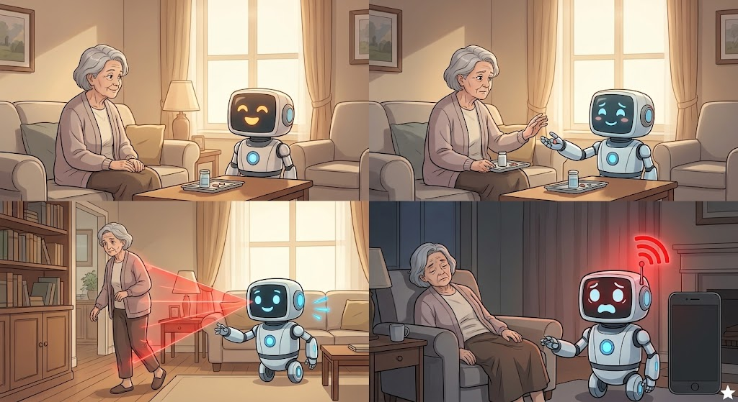
Proposed Solution
Reminds medicine on schedule with a warm voice alert and expressive face — not just a beep.
The robot understands the user's mood and gives caring reminders. If the user ignores or refuses the medicine, it gently talks to them and encourages them to take it.
Detects presence and movement, actively engaging even when the user tries to avoid it.
Detects gas leaks in the room and sends emergency SMS instantly to pre-defined numbers.
06

Slide 7
Literature Gap
Unique | Handles Forgetting | Handles Emotional Refusal | Limitation
Reminder Apps & Alarms — simple, low-cost scheduled alerts | Yes — basic alerts | No | Cannot detect refusal or confirm the dose was taken
Non-Adherence Research [1,2,3] — identifies forgetting & unwillingness as dual causes | Explains the cause only | Explains the cause only | Theoretical — no deployable product
Social / Assistive Robots [4,5,6] — builds trust via social interaction | No | Yes — builds trust & engagement | Not purpose-built for medicine scheduling or confirmation
Quantitative Evidence (2024–25 studies) [7–10] — provides measurable outcome data | Similar IoT dispensers report 88–98% dose-confirmation rates [7] | Companion robots cut high-depression-risk share by ~45% and lift adherence over 6 months [8] | No single system yet reports both outcomes together
Smart Medicine Companion Robot (Ours) — reminder, persuasion & emergency alert in one system | Yes [Survey Analysis ] | Yes | Prototype stage — field evaluation is proposed future work
07

Slide 8
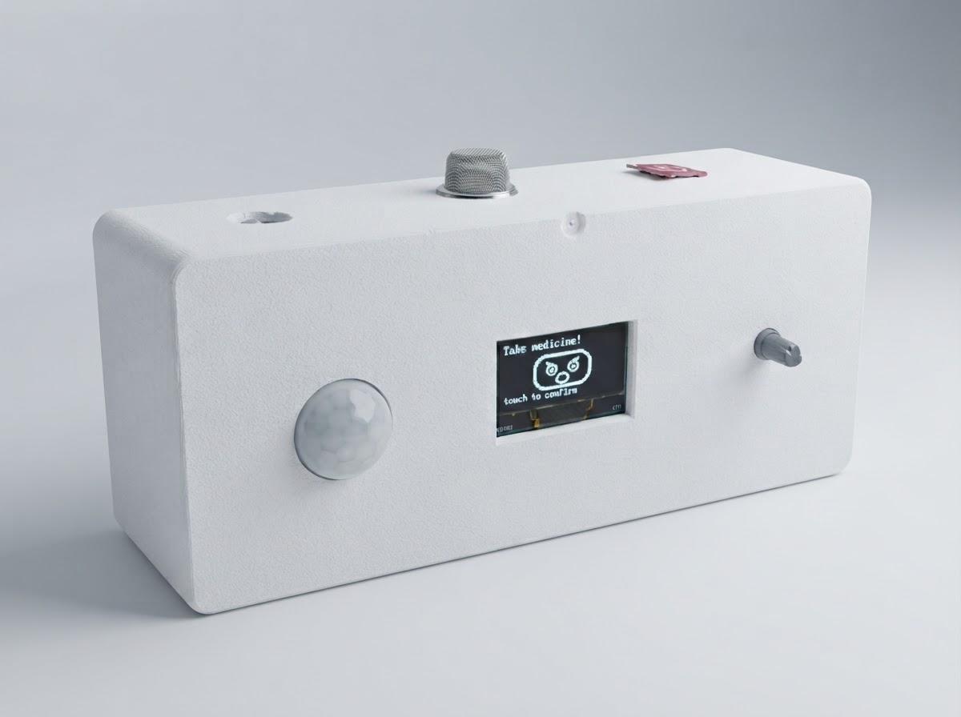
Concept Model: Solving Both Sides of Non-Adherence
Forgetting
Wrong time, wrong dose, or no memory of taking it at all
Unwillingness
Low mood, denial, or simply not feeling like it today
Reminder + Confirmation
Voice alarm, RTC schedule, persistent alerts until the button is pressed
Emotional Engagement
Empathetic voice persuasion and mood-aware facial expressions
Smart Medicine Companion Robot
Medicine Actually Taken
Caregiver Peace of Mind
Emergency Safety Net
08

Slide 9

Hardware Components
ESP32-S3-WROOM-1 (N16R8)
0.96″ I2C OLED Display
HC-SR501 PIR Sensor
DS3231 RTC (ZS-042)
INMP441 I2S Microphone
MAX98357A I2S Amplifier
3W 8Ω Speaker
KY-040 Rotary Encoder
MQ-2 Gas Sensor
TTP223 Touch Module
SIM800L GSM Module
MP1584 Buck Converter
1000 µF Capacitor
DC Jack
5V/3A Adapter
Resistors ×4 (SIM800L divider)
09

Slide 10
Components Budget
1 | ESP32-S3-WROOM-1 (N16R8) Board | 1 | ৳950
2 | KY-040 Rotary Encoder | 1 | ৳110
3 | HC-SR501 PIR Sensor | 1 | ৳95
4 | TTP223 Touch Module | 1 | ৳40
5 | INMP441 I2S Microphone | 1 | ৳245
6 | 0.96″ I2C OLED Display | 1 | ৳350
7 | DS3231 RTC Module (ZS-042) | 1 | ৳345
8 | MQ-2 Gas Sensor Module | 1 | ৳160
9 | SIM800L GSM Module | 1 | ৳650
10 | MAX98357A I2S Amplifier | 1 | ৳601
11 | 3 W, 8 Ω Speaker | 1 | ৳450
12 | MP1584 Buck Converter | 1 | ৳90
13 | 1000 µF Capacitor | 1 | ৳15
14 | DC Jack | 1 | ৳20
15 | 5 V / 3 A Adapter | 1 | ৳350
16 | Resistors (SIM800L divider) | 4 | ৳10
 | Total |  | ৳4,481
10

Slide 11
Robot Functionalities
Medicine Reminder
Alerts the user at the set time with voice and face expression.
Reminder (Sad)
Persistent Alarm
Voice alarm continues until the user confirms medicine taken.
Waiting for Confirmation
Face Reactions
Shows different expressions: reminder (sad/concerned), confirmed (happy).
Voice Assistant
Uses AI voice for natural interaction and instructions.
Confirmed (Happy)
Movement Detection
Detects user presence and engages automatically.
Emergency SMS
Detects gas leaks in the room and automatically sms pre-defined numbers.
11

Slide 12
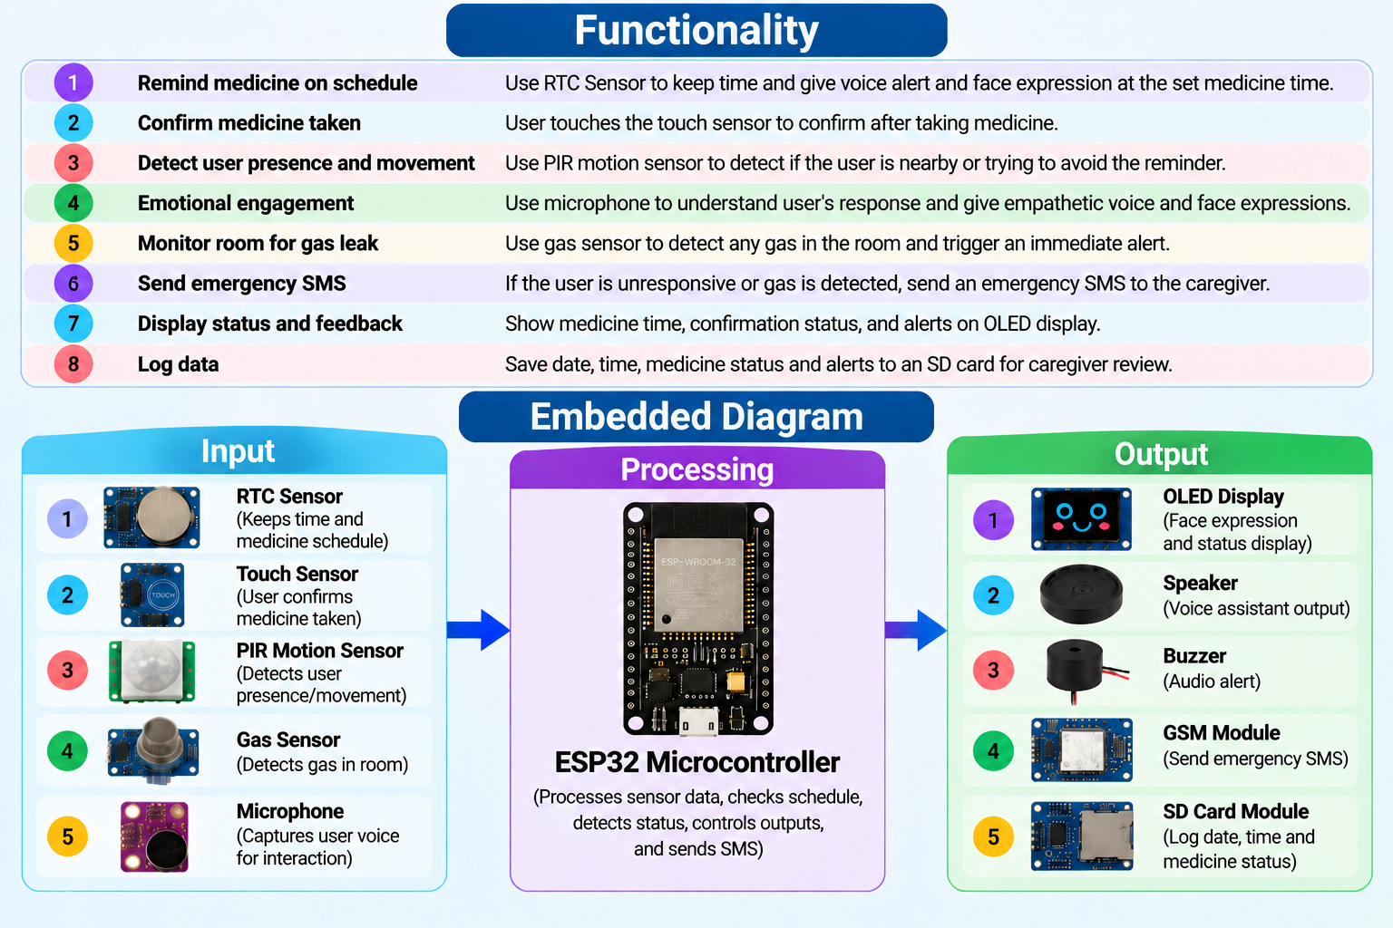
Robot Embedded Diagram
12

Slide 13
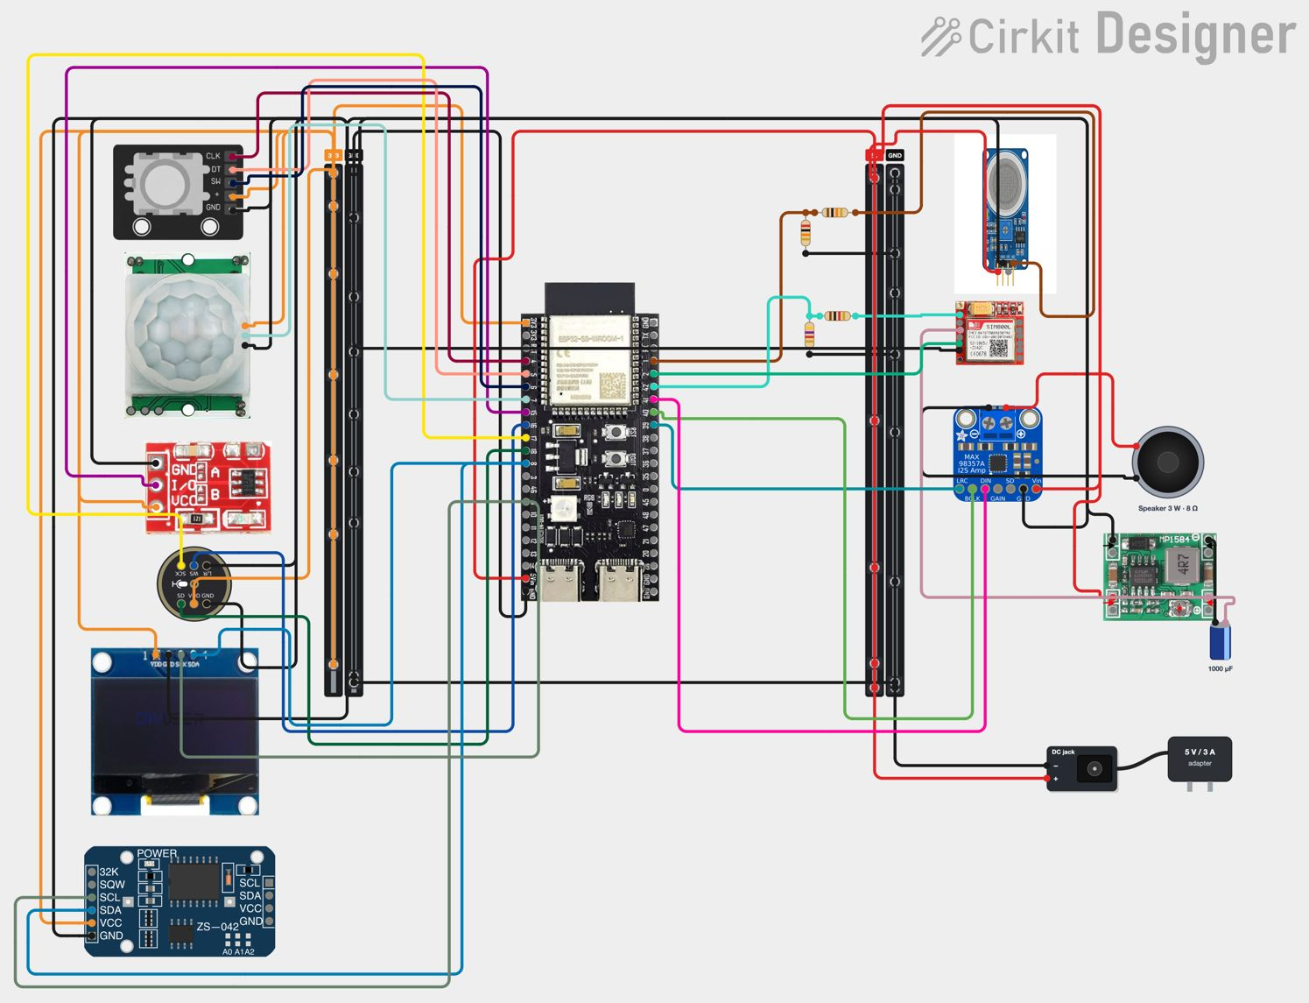
Robot Circuit Diagram
13

Slide 14



Robot Workflow
User Sets
Medicine Schedule
RTC Checks
Time
Time Match
(Medicine Time)
User Takes
Medicine
User Confirms
(Press Button)
Time, medicine
name & frequency
DS3231 RTC
module real-time
Alarm triggers
voice + face reaction
Robot keeps
reminding
Alarm stops,
happy face & voice
Gas Detected
(MQ-2 Sensor)
No Confirmation
(Timeout)
Log Saved
(SD Card)
Emergency SMS sent
to caregivers instantly
Alarm continues
& alerts again
Stores an updated
record of medicine
14

Slide 15
Robot Workflow Diagram
START
Save to Log
Initialize Sensors
Give medicine reminder
Stop Reminder
Gas detect?
Yes
No
User take medicine?
Send Emergency Alert
Yes
No
Continue Reminder
Send Emergency SMS
User Present?
No
Is it medicine time?
Emotional
Engagement
Yes
Emotional Engagement
No
Yes
No
15

Slide 16

Pseudocode
START
INITIALIZE robot
INITIALIZE sensors
LOAD medicine schedule
WHILE system active DO
CHECK gas sensor
SEND emergency alert if gas detected
READ current time
CHECK medicine time
GIVE medicine reminder
WAIT for user response
CONFIRM medicine status
SAVE medicine log
REPEAT reminder if medicine not taken
CHECK user presence
START emotional engagement
SEND emergency SMS if required
END WHILE
RETURN to standby mode.
16

Slide 17
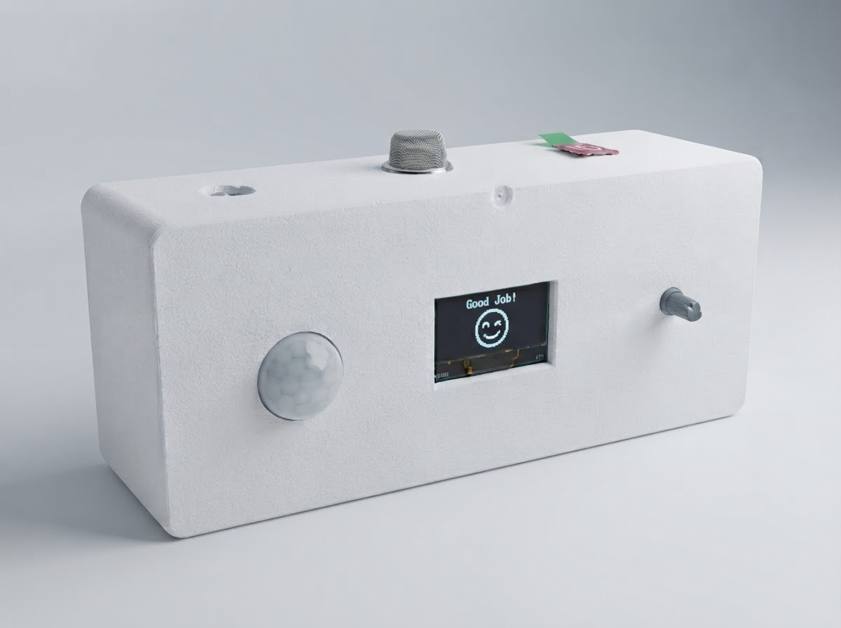
Conclusion
The Smart Medicine Companion Robot is a compact, intelligent, and interactive solution for medicine management.
It improves medication adherence, ensures safety, and brings peace of mind to users and caregivers.
It combines robotics, IoT, voice interaction, and emotional engagement in one platform.
This project has strong potential to make a real-world impact in healthcare.
“Technology with Care, Health Everywhere.”
17

Slide 18
References
1
Stewart, S.-J. F., Moon, Z., & Horne, R. (2023).
Medication nonadherence: Health impact, prevalence, correlates and interventions.
Psychology & Health, 38(6), 726–765.
4
Zafrani, O., Nimrod, G., & Edan, Y. (2023).
Between fear and trust: Older adults’ evaluation of socially assistive robots.
International Journal of Human-Computer Studies, 171, 102981.
2
Jayasree, A., Shanmuganathan, P., Ramamurthy, P., & Alwar, M. C. (2024).
Types of medication non-adherence & approaches to enhance medication adherence in mental health disorders: A narrative review.
Journal of Pharmacy Practice.
5
Proceedings of the 36th International BCS Human-Computer Interaction Conference (2023).
Exploring the potential of social robots in supporting home medication management.
BCS Learning & Development.
3
King, K., Czuber-Dochan, W., Chalder, T., & Norton, C. (2025).
Medication non-adherence in inflammatory bowel disease: A systematic review identifying risk factors and opportunities for intervention.
Pharmacy, 13(1), 21.
6
Journal of Sport and Health Science (2025).
Artificial intelligence-powered social robots for promoting physical activity in older adults: A systematic review.
Elsevier, on behalf of Shanghai University of Sport.
18

Slide 19
References
7
Peddisetti, V., Kandregula, P. K., John, J. A., Poomdla, S., George, K., & Panangadan, A. (2024).
Smart medication management: Enhancing medication adherence with an IoT-based pill dispenser and smart cup.
2024 IEEE AIMHC, 137–144.
10
Monisha, M., Sarumathi, S., & Pratheeba, R. (2025).
IoT enabled gas leak detection and safety automation system.
IJARCCE, 14(5), DOI:10.17148/IJARCCE.2025.14520
8
Jung, H. W., Kim, Y., Kim, H., Kim, M., Lee, H., Park, J. Y., Kim, W. J., & Park, J. (2025).
Socially assistive robot Hyodol for depressive symptoms of community-dwelling older adults in medically underserved areas: A preliminary study.
Journal of Clinical Medicine, 15(1), 217.
11
Blavette, L., Dacunha, S., Alameda-Pineda, X., et al. (2025).
Acceptability and usability of a socially assistive robot integrated with a large language model in a geriatric care institution.
JMIR Human Factors, 12, e76496.
9
Babu, T., Nair, R. R., Kishore, S., & Vineeth, M. (2024).
Enhancing gas leak detection with IoT technology: An innovative approach.
Procedia Computer Science, 235, 961–969.
19

Slide 20

Thank You For Your Attention
20

